Slide 1


What I Learned at ISBG
TRAINING REVIEW
M SHAKTHI RAJ
Engineer Assistant
30/10/2026
Information Systems Bangalore · PC Maintenance (PCM)
Information Systems, Bangalore Complex
Notes:
HOW TO START (about 30 seconds): "Good morning sir. Over the last few weeks I have been going through the sub-departments of ISBG. I am posted in PC Maintenance, so I will first introduce ISBG very briefly, and then walk you through what I learned in PCM and in the Network Monitoring Center: the help desk, the servers, antivirus support and the network." TIPS: The whole talk is about 10 to 12 minutes, roughly one minute per slide. Speak slowly, look at your manager rather than the screen, and use the slides only as prompts.

Slide 2







About ISBG
ISO/IEC 27001:2022 certified · my posting is highlighted
PC Maintenance
Network Maintenance
Payroll and Attendance
Hardware and software support
Internet and intranet upkeep
Permanent, temporary and contract staff
Web Support
Face Recognition Attendance
SAP / ERP Support
Intranet applications
Flap barriers and biometrics
Help for end users at the complex
ISBG training review · BEL Bangalore Complex
02
Notes:
ABOUT 1 MINUTE. Say: "ISBG is the Information Systems division of the Bangalore Complex, and it is ISO/IEC 27001:2022 certified for information security. It looks after six areas: PC maintenance, network maintenance, payroll and attendance, web support, face recognition based attendance with flap barriers and biometrics, and SAP/ERP support for end users. I am posted in PC Maintenance, highlighted here, so the rest of my talk focuses on it."

Slide 3
Vision, values and information security
VISION
VALUES
Be the leader in IT infrastructure support and maintenance for internal customers, through dedicated service, self-discipline and teamwork.
Customers first
Transparency, honesty and integrity
Ethical business practices
Striving for excellence
Trust and respect for individuals
Teamwork
MISSION
Be customer focused and deliver excellent IT infrastructure support for customer delight.
ISO/IEC 27001:2022
Protects information
Serves every SBU
Ver 2.0, dated 16 May 2025. Valid from 16/12/2025 till 15/12/2028
Confidentiality, integrity and availability
ERP support, IT assets and network for the Bangalore Complex
ISBG training review · BEL Bangalore Complex
03
Notes:
ABOUT 1 MINUTE. Do not read every line. Say: "Our vision is to lead in IT infrastructure support for internal customers, and our mission is customer delight. The values that guide the team are customers first, transparency and integrity, ethical practices, excellence, mutual trust and respect, and teamwork. ISBG is also certified under ISO/IEC 27001:2022, the information security standard. The certificate is version 2.0, dated 16 May 2025, valid from 16 December 2025 till 15 December 2028. The aim is to protect the confidentiality, integrity and availability of information, and ISBG supports mission-critical ERP and maintains the IT assets and network for all the SBUs of the Bangalore Complex."

Slide 4

PC Maintenance: handling a complaint
PCM covers: help desk and field support, server maintenance, antivirus support, printers, workstations, thin clients, and hardware and software issues.
1
2
3
4
5
6
Call received
Ticket raised
Remote fix
Experts
Zone engineer
Ticket closed
User calls the help desk
Staff no., name and department noted
Remote access tried for software issues
Escalated if not resolved
On-site visit for physical or hardware issues
Issue resolved and recorded
12
zone engineers, each covering 5 to 10 departments (one zone). Hardware issues go straight to the zone engineer.
16 SBUS ACROSS THE 12 ZONES (SAMPLE DATA)
Zone 1
Zone 2
Zone 3
Zone 4
Zone 5
Zone 6
Zone 7
Zone 8
Zone 9
Zone 10
Zone 11
Zone 12
SBU A, B
SBU C, D
SBU E, F
SBU G, H
SBU I
SBU J
SBU K
SBU L
SBU M
SBU N
SBU O
SBU P
8 depts
7 depts
6 depts
9 depts
7 depts
5 depts
8 depts
10 depts
6 depts
7 depts
8 depts
9 depts
ISBG training review · BEL Bangalore Complex
04
Notes:
ABOUT 2 MINUTES. This is the main slide, so take your time. Start with the strip at the top: "PC Maintenance is the part of ISBG I am posted in. It covers help desk and field support, server maintenance and antivirus support, and also printers, workstations, thin clients and general hardware and software issues." Then walk the flow left to right: "When a user has a problem, they call the help desk. The first thing the help desk does is raise a ticket with the user's staff number, name and department. If it is a software issue, they first try to fix it through remote access. If that does not work, the ticket goes to the experts. If the experts cannot fix it, or the issue needs someone physically present, a zone engineer is sent. We have 12 zone engineers, and each covers a zone of 5 to 10 departments. Hardware issues also go to the zone engineer. Once the problem is fixed, the ticket is closed." Finally the zone row: "BEL has 16 SBUs divided across the 12 zones, so each zone has one or two SBUs and on average about 5 to 10 departments." BEFORE PRESENTING: the SBU names (SBU A to P) and the department counts in the 12 zone tiles are sample data. Replace them with the real SBU names and averages for each zone.

Slide 5

Server maintenance
FLEET
SERVER TYPES
DISK PROTECTION (RAID)
85
Flat
Mount
Blade
RAID 1
Mirroring · 2 disks
physical servers under PCM, ISBG
RAID 5
Striping · 3+ disks
Hot-swappable disks: a failed drive can be replaced without shutting the server down.
ISBG training review · BEL Bangalore Complex
05
Notes:
ABOUT 1 MINUTE. Say: "PCM maintains 85 physical servers in three categories: flat, mount and blade. To protect the data, the servers use RAID, which manages multiple hard disks together. We use RAID 1, which is mirroring, when there are two disks, and RAID 5, which is striping, when there are three or more. The disks are hot-swappable, so a faulty drive can be replaced without taking the server down." If asked: RAID 5 also keeps parity information, so it survives one disk failure.

Slide 6
Server roles
Role | What it does
Active Directory | Stores users, computers and shared folders. Adding or removing a user needs the PCM head's permission; senior officials have no policy restrictions.
DHCP | Assigns IP addresses to client PCs on a 30-day lease, so an idle PC's IP can go to a different PC. Static IPs are set manually, for servers only.
DNS | Resolves host names to IP addresses
Hyper-V | Runs several operating systems on one server, for example a virtual server for Active Directory
Windows Update service | Delivers Windows updates to PCs
Windows Deployment | Installs the OS on PCs over the network
Web server | Hosts web applications
ISBG training review · BEL Bangalore Complex
06
Notes:
ABOUT 1.5 MINUTES. Say: "Each server is given a role. Active Directory holds user, computer and shared folder information. Adding or removing a user is done only with permission from the PCM head, and policies apply to staff, but senior officials have no restrictions. DHCP assigns IP addresses to all client PCs with a 30-day lease, so the IP of an idle PC can be given to a different PC. Static IP addresses are assigned manually, and only for servers. DNS resolves names. Hyper-V is virtualization software, so one physical server can host several operating systems, for example a virtual server for Active Directory. The Windows update service and the deployment server handle updates and OS installation, and the web server hosts web applications."

Slide 7



Antivirus support with Trend Micro
Apex One server
Apex Central server
SQL database server
Backup server
Primary endpoint protection for about 4,800 PCs
Centralized management of the antivirus setup
Microsoft SQL Server on a VM; stores Apex One data
Powered on once a month to back up the antivirus, then shut down
WHAT THE ANTIVIRUS TEAM DOES
Disable antivirus temporarily when a user installs software or transfers data
Push the agent to users and apply the policy
Enable or disable USB ports for users
Set CD/DVD permissions
ISBG training review · BEL Bangalore Complex
07
Notes:
ABOUT 1.5 MINUTES. Say: "For antivirus we use Trend Micro. The Apex One server is the primary endpoint protection service and manages about 4,800 PCs. Apex Central is the centralized management server. A SQL database server, running Microsoft SQL Server on a VM, stores the Apex One data. A separate backup server is powered on once a month, backs up the antivirus setup, and is shut down again." Then the bottom half: "Day to day, the antivirus team does four things. It disables the antivirus for a user when they need to install software or transfer data. It pushes the agent to users under a policy. It enables or disables USB ports for users. And it sets CD/DVD permissions. These controls help keep the network safe while still letting users do their work."

Slide 8
Other PCM activities
IT ASSET MAINTENANCE: THREE CATEGORIES
AMC
Warranty
On call
Annual Maintenance Contract with IND Innovations, covering IT assets manufactured after 2017
Where AMC is not applied, repairs and replacements are claimed under warranty
Not under AMC or warranty, and manufactured before 2017. Support is still given, but spare parts are not replaced
VDI and non-VDI support
Non-maintainability certificate
PCM supports both kinds of system. These tasks are done by the VDI team:
Issued for IT assets of the BG Complex that can no longer be supported or repaired (write-off)
Giving VDI access to new users and removing existing users
Creating drives for VDI systems
Giving and removing user restrictions
ISBG training review · BEL Bangalore Complex
08
Notes:
ABOUT 1.5 MINUTES. Say: "Besides complaints, servers and antivirus, PCM does a few other activities. First, IT asset maintenance, which falls into three categories. AMC is the Annual Maintenance Contract with IND Innovations, and it covers IT assets manufactured after 2017. Where AMC is not applied, repairs and replacements are claimed under warranty. On call is for assets that are under neither AMC nor warranty and were manufactured before 2017. We still give support for them, but spare parts are not replaced. Second, we support both VDI and non-VDI systems, with all kinds of support. The VDI-specific tasks are done by the VDI team: giving VDI access to new users and removing existing users, creating drives for VDI systems, and giving or removing user restrictions. Third, we issue a non-maintainability certificate for IT assets of the BG Complex that can no longer be supported or repaired, which is how they are written off."

Slide 9


Network Monitoring Center (NMC)
The NMC watches over BEL's network and acts on faults, new connections and hardware problems.
New connections
Network issue resolution
Network hardware issues
Providing network connections to users and departments
Finding and fixing faults reported by users or raised by monitoring
Switches, routers and other network equipment
ALSO PART OF NMC WORK
Device and link monitoring
Fault logging and escalation
Configuration backups
Uptime reports
ISBG training review · BEL Bangalore Complex
09
Notes:
ABOUT 1 MINUTE. Say: "The next sub-department I learned about is the NMC, the Network Monitoring Center. It monitors the BEL network and takes action when something goes wrong. Its main responsibilities are giving new network connections, resolving network issues, and handling network hardware problems such as switches and routers." The four "Also part of NMC work" items are general good practice for a network center. Mention only the ones you actually saw, and drop the rest.

Slide 10
The network in BEL
Intranet
Internet
ERP, internal mail, IP telephony and video conferencing
External mail, web browsing and e-procurement
THE INTRANET IS DIVIDED INTO 3 ZONES
MCE zone
MS-DC zone
EW&A-DC zone
172.193.x.x
172.195.x.x
172.194.x.x
Main zone: connects all the other zones
Connects its own departments
Connects its own departments
Ring topology: the zones are connected in a closed loop, each linked to two neighbours. If one link fails, traffic goes the other way round. Departments connect to their own zone; MCE serves many.
ISBG training review · BEL Bangalore Complex
10
Notes:
ABOUT 1.5 MINUTES. Say: "BEL has two kinds of network, the intranet and the internet, and they are kept separate. The intranet carries the ERP, internal mail, IP telephony and video conferencing. The internet network is used for external mail, browsing and e-procurement. The intranet is divided into three zones. The MCE zone is the main zone and connects the other zones. Its IP series is 172.193. The MS-DC zone uses 172.195 and the EW&A-DC zone uses 172.194. The zones are connected in a ring topology. In a ring, every zone is connected to two neighbours, so the connections form a closed loop. The benefit is redundancy: if one link between two zones fails, traffic can still reach its destination the other way around. From each zone, connections go out to the departments it serves, and the MCE zone serves many departments." The intranet and internet service lists come from the ISBG ISO 27001 reference deck. I have not expanded MCE, MS-DC or EW&A-DC because the full forms were not given.

Slide 11



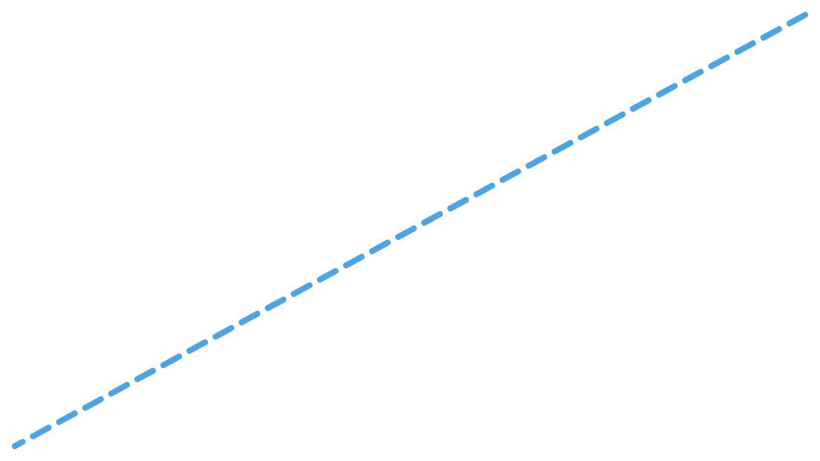

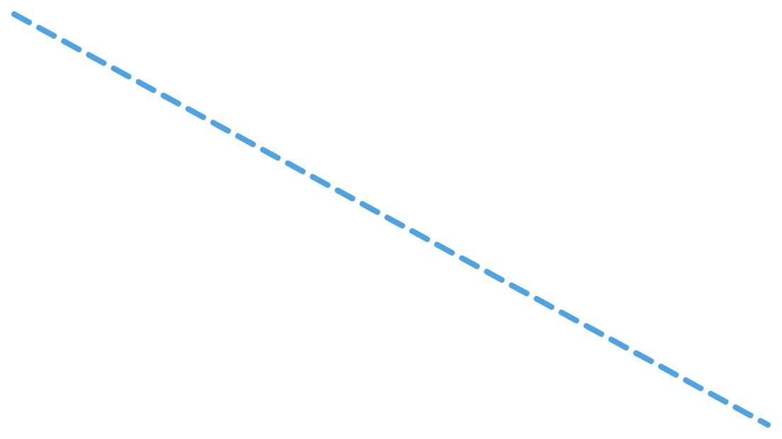

Intranet network architecture
SAP server and VC (data centre)
SIP server (voice)
VDI-DC (virtual desktops)
Data + VC network: 2 x 100G links
MCE-DC (main zone)
Access switches, 10G downlinks, PCs and VoIP phones
VoIP network: separate, 2 x 40G links
172.193.x.x · core switch · firewall
2 x 100G
2 x 100G
EW&A-DC
2 x 100G
MS-DC
172.194.x.x · core switch · firewall
172.195.x.x · core switch · firewall
Access switches, 10G downlinks, PCs and VoIP phones
Access switches, 10G downlinks, PCs and VoIP phones
ISBG training review · BEL Bangalore Complex
11
Notes:
ABOUT 1 MINUTE. This is the redrawn intranet architecture diagram. Walk through it from the middle outwards. Say: "The intranet is built around three zones, MCE-DC, EW&A-DC and MS-DC. Each has its own core switch and firewall, and the IP series are 172.193, 172.194 and 172.195. The zones are joined to each other by 2 x 100G links, so they form a triangle with no single point of failure. Users connect through access switches with 10G downlinks, using PCs and VoIP phones. The data-centre servers, such as the SAP server, VC, the SIP server for voice and the VDI-DC, are attached at MCE-DC. Voice also has its own separate VoIP network with its own core switches and 2 x 40G links, shown by the dashed lines." BEFORE PRESENTING: I redrew this from a sideways photo. Check the link speeds (2 x 100G, 2 x 40G, 10G) and which servers sit at MCE-DC against your printed original.

Slide 12
The architecture in brief
Three zones, each with a core
High-speed core ring
MCE-DC, EW&A-DC and MS-DC each have a core switch and a firewall. MCE-DC is the main zone, and the data-centre servers are attached to it.
The zones are joined by 2 x 100G links in a triangle. If one link fails, traffic uses the other route.
Users reach the core through access switches
Separate VoIP network
PCs and VoIP phones plug into access switches, which connect to their zone's core over 10G downlinks.
Voice has its own core switches and 2 x 40G links, so calls and data traffic do not compete.
ISBG training review · BEL Bangalore Complex
12
Notes:
ABOUT 45 SECONDS. Say: "To summarise the architecture: there are three zones, each with its own core switch and firewall, and MCE-DC is the main one, where the data-centre servers are attached. The zones are joined by 2 x 100G links in a triangle, so the network keeps working if one link fails. Users connect through access switches over 10G downlinks. Voice runs on its own separate VoIP network, so calls do not compete with data traffic." Keep the firewall details light unless you are asked: the diagram shows a firewall at each zone, with active-active firewalls for the data centres.

Slide 13

Air gap and data diode
BEL keeps the intranet and internet as physically separate networks (an air gap). A data diode lets data move between them in one direction only.
Source network
Data diode
Destination network
Sends data
One-way hardware link
Receives data
No return path
1. Send
2. One-way link
3. Receive
The sender converts the data into a light signal
One side can only send and the other can only receive
The receiver turns the light back into data
ISBG training review · BEL Bangalore Complex
13
Notes:
ABOUT 1 MINUTE. Say: "BEL keeps the intranet and the internet as physically separate networks, which is called an air gap. Where data has to pass from one network to the other, we use a data diode. A data diode is a hardware device that allows data to travel in one direction only. Inside it, the sending side has only a transmitter that turns the data into a light signal, and the receiving side has only a receiver that turns the light back into data. There is no hardware path in the opposite direction, so nothing can travel back. This means malware or a remote attacker on the outside cannot reach the protected network through it, and data cannot leak back the other way." BEFORE PRESENTING: I have drawn the diode generically as source to destination, because the direction BEL uses was not given. If you know which way data flows (for example, internet to intranet or the reverse), change the two box labels. The light-signal explanation is how optical data diodes work in general.

Slide 14
NMC tools and special networks
NNMi
WIQAS network
Network Node Manager i
[Full form to be confirmed]
Discovers devices and maps the network
Monitors the health of devices and links
Alerts the team when a device or link goes down
Helps find the root cause of a fault faster
A separate, dedicated network
Used by the Army, Navy and Air Force
Lets each service communicate on its own network
ISBG training review · BEL Bangalore Complex
14
Notes:
ABOUT 1 MINUTE. Say: "To monitor the network the NMC uses NNMi, which stands for Network Node Manager i. It automatically discovers the network devices and shows how they are connected. It monitors the health of devices and links, and raises an alert when something goes down, which helps the team find the root cause quickly. We also support the WIQAS network, which is a separate network used by the Army, Navy and Air Force so that each service can communicate on its own network." BEFORE PRESENTING: replace the WIQAS placeholder with its full form. I could not confirm it, so I did not guess. Ask your guide or check the training notes, and do not spend time on it if you are unsure.

Slide 15
Key takeaways
1
Every complaint is ticketed and tracked until the ticket is closed.
2
85 servers run on RAID disks, with Hyper-V for separate services.
3
Trend Micro Apex One protects about 4,800 PCs and controls USB and CD/DVD.
4
NMC monitors the intranet and internet with NNMi and fixes network faults.
Thank you. Questions?
Training continues across the other ISBG sub-departments.
ISBG training review · BEL Bangalore Complex
15
Notes:
HOW TO END (about 45 seconds): Read the four takeaways in your own words, then say: "To summarise, in PCM I learned how complaints are handled from the help desk to the zone engineers, how the 85 servers are protected and organised, and how antivirus is managed for about 4,800 PCs. I also learned how the NMC monitors the BEL network and resolves faults. My training in the other ISBG sub-departments is still continuing. Thank you, sir. I would be happy to take any questions and would value your feedback." TIPS FOR Q&A: If you do not know an answer, say "I will check with the team and confirm" instead of guessing. Keep a few facts ready: 85 servers, 12 zone engineers covering 5 to 10 departments each, about 4,800 PCs on Apex One, 30-day DHCP lease, intranet zones 172.193 (MCE, main), 172.194 (EW&A-DC) and 172.195 (MS-DC) in a ring.

